Slide 1
Innovative Discovery of Unique Collections: The Case of the
Makino Mamoru Collection at Columbia University”
by Jim Cheng and Beth Katzoff
CEAL , “Open Access and Discovery in the Academic Universe: Next Steps for East Asian Studies Research and Library Development”
March 20, 2013

Slide 2
Ways to promote unique collections
Symposia
Columbia YouTube
Academic Commons (Open Access at Columbia)
Websites
Blogs
Finding Aids, online catalogs (more traditional means)

Slide 3
“The Makino Collection at Columbia: the Present and Future of an Archive, A Symposium,” November 11, 2011
Makino Collection Finding Aid draft (in process)
http://library.columbia.edu/content/dam/libraryweb/libraries/eastasian/makino/Guide-Makino_Mamoru_Collection-June_2011_draft.pdf
Makino Collection Website
http://library.columbia.edu/indiv/eastasian/special_collections/makino_mamoru.html
Makino Symposium Website
http://library.columbia.edu/indiv/eastasian/special_collections/makino_mamoru/symposium.html
YouTube channel at Columbia
http://www.youtube.com/user/columbiauniversity/videos?query=makino+symposium
Academic Commons
http://academiccommons.columbia.edu/
Makino Collection Blog
https://blogs.cul.columbia.edu/makino/

Slide 4
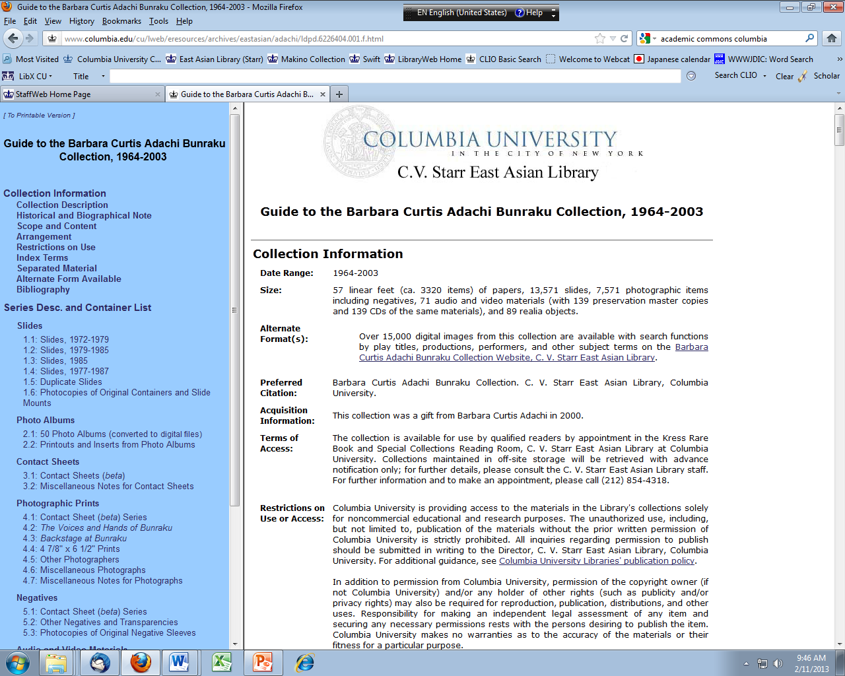

Slide 5
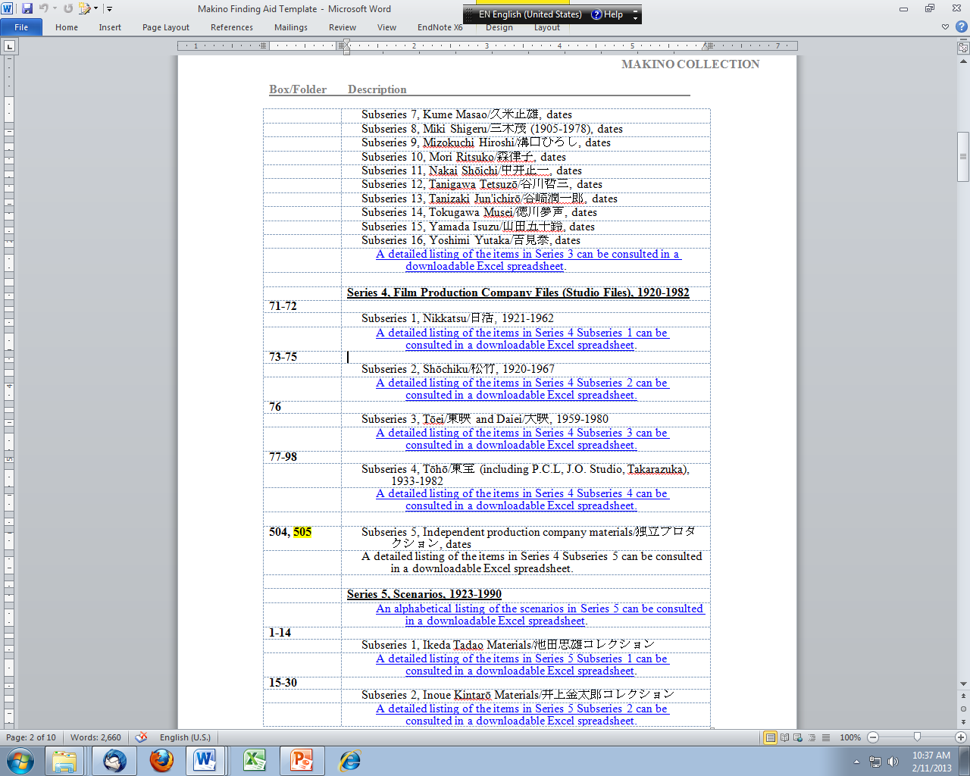

Slide 6
Recent Symposia at Starr Library
Tibetan Studies symposium, Feb. 2009
video proceedings
http://library.columbia.edu/indiv/eastasian/tibetan/2009_conference/video.html
Chinese film festival and conference, Oct. 2011
website
http://arts.columbia.edu/cinema-china-culture-china-film-festival-and-conference
Makino film symposium, Nov. 2011
website
http://library.columbia.edu/indiv/eastasian/special_collections/makino_mamoru/symposium.html
YouTube channel at Columbia
http://www.youtube.com/user/columbiauniversity/videos?query=makino+symposium
Academic Commons
http://academiccommons.columbia.edu/
Korean film symposium, March 2012
website
http://library.columbia.edu/indiv/eastasian/korean/rarespecial/conant_collection/conantsymposium.html

Slide 7
Open Access can be digital
Academic Commons: http://academiccommons.columbia.edu/
“Academic Commons is Columbia University's digital repository where faculty, students, and staff of Columbia and its affiliate institutions can deposit the results of their scholarly work and research. Content in Academic Commons is freely available to the public.”
“Open Access (OA) literature is digital, online, free of charge, and free of most copyright and licensing restrictions” (Peter Suber, Open Access. MIT Press, 2012, p. 4).
Open Access is not just written literature.
“In principle, any kind of digital content can be OA, since any digital content can be put online without price or permission barriers. Moreover, any kind of content can be digital: texts, data, images, audio, video, multimedia, and executable code. We can have OA music and movies, news and novels, sitcoms and software – and to different degrees we already do.” (p. 9)

Slide 8
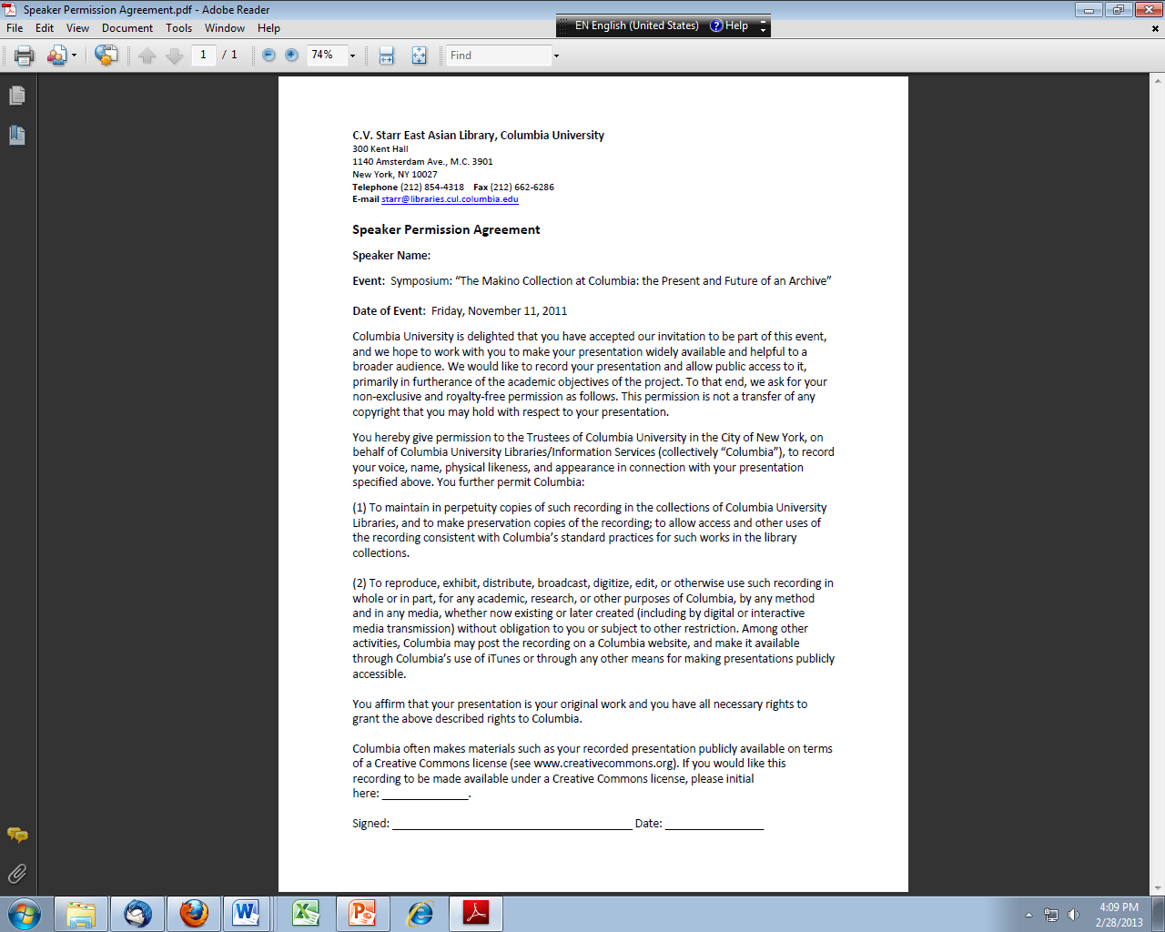

Slide 9
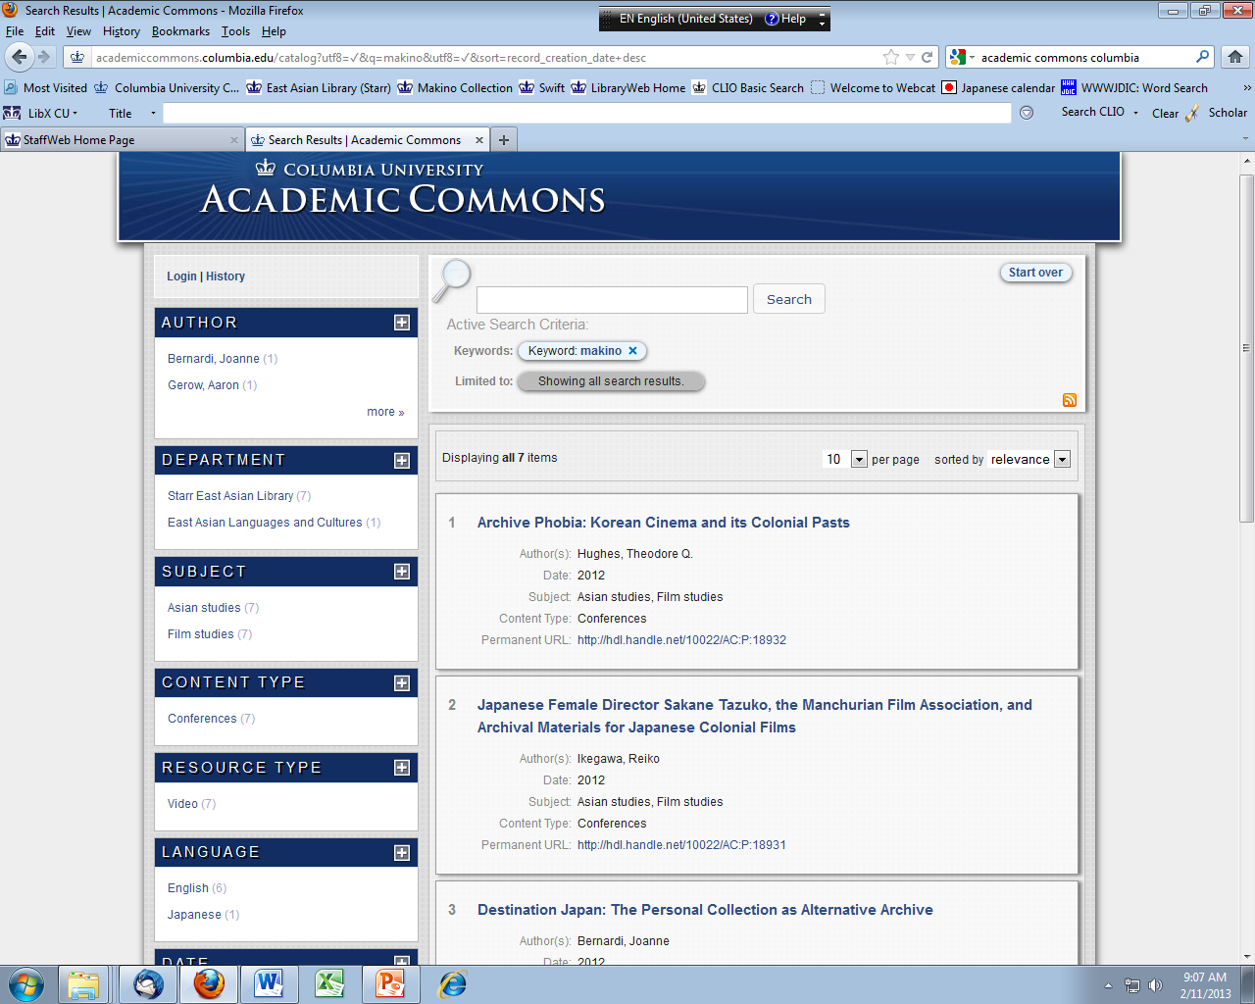

Slide 10
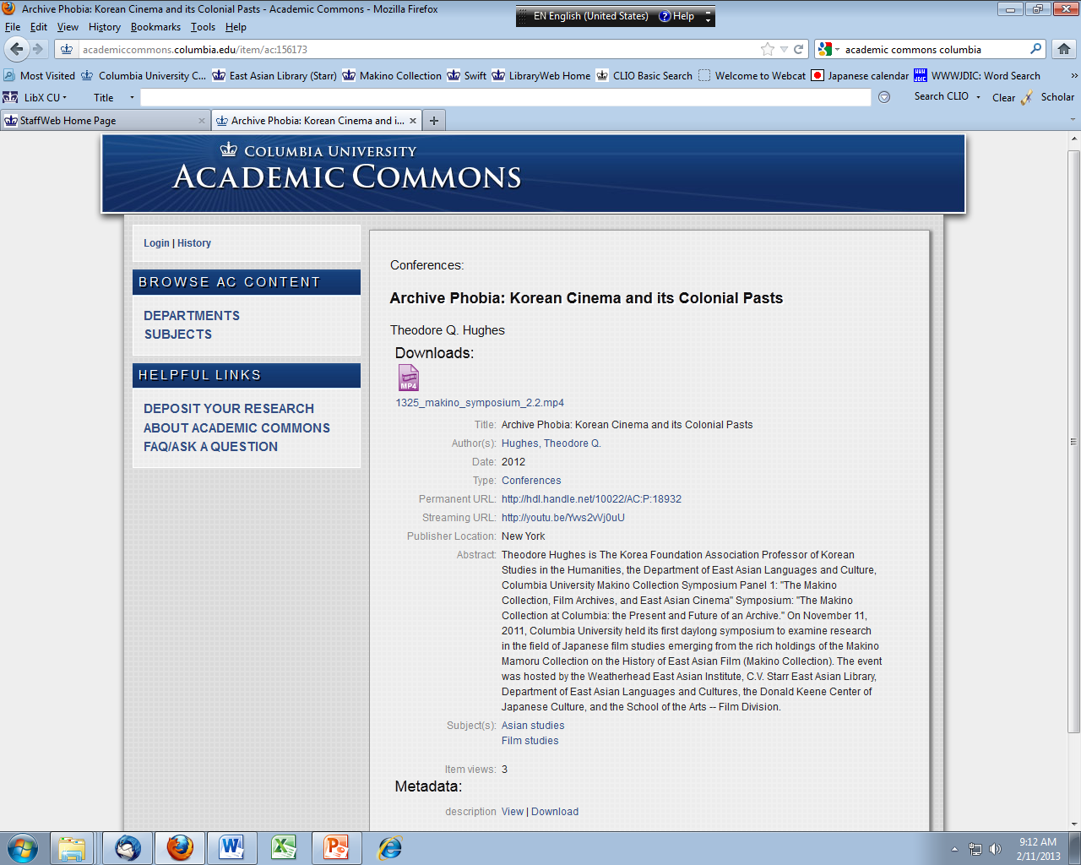

Slide 11
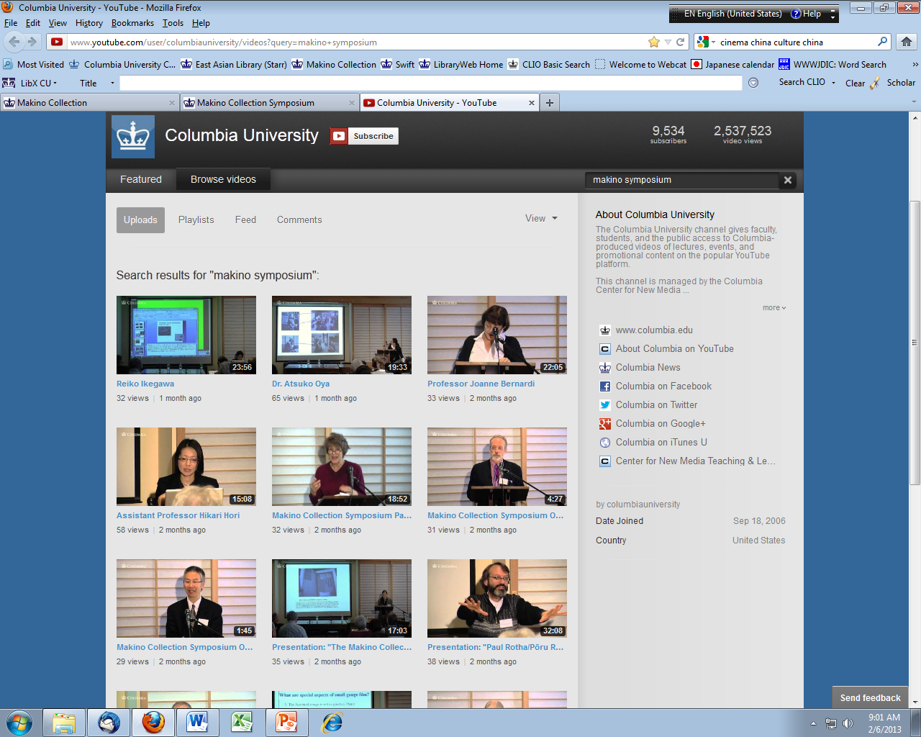

Slide 12
About the Makino Collection/牧野コレクション)
Columbia University Library purchased the Makino Collection in 2006 and it arrived in New Jersey in 2007
Processing began in mid-September 2008, and continues today.
An online Finding Aid (EAD) is in process. It will be searchable in the Columbia online catalog (CLIO) and linked to the Archive Collections Portal (http://archivesportal.cul.columbia.edu/) from the Library website.
Over 80,000 items:
14,576 volumes of books
10,028 volumes of magazines
1,805 miscellaneous files
341 various formats – VHS (291), posters (60), sound recordings (8)

Slide 13
Contents of the Makino Collection/牧野コレクション
over 900 linear feet of archival documents, monographs, magazines, newspapers, posters, photographs, maps, and more.
over 1,000 scenarios (scripts), many handwritten
over 3,000 handbills from regional movie theaters (1910s - 1940s)
film production company documents from Tōhō/東宝, Shōchiku/松竹, Nikkatsu/日活, Tōei/東映and Daiei/大映 , independent studios
personal collections of film critics - Kishi Matsuo, Tanaka Jun’ichiro, Iwasaki Akira, and Iijima Tadashi.
major and minor film magazines
coterie (self-published) magazines (dōjinshi/同人誌)
Amateur film (kogata eiga/小型映画) materials
East Asian film sources (China, Taiwan, Manchuria, South Korea)
Western cinema (Charlie Chaplin, Russian materials)

Slide 14
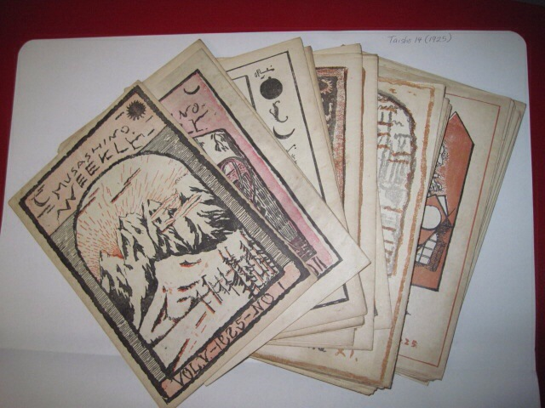
Movie Theater Handbills/chirashi, 1925
Tokyo/東京, Shinjuku/新宿, Musashinokan/武蔵野館,
Musashino Weekly/武蔵野週報, vol. 5, 6,

Slide 15
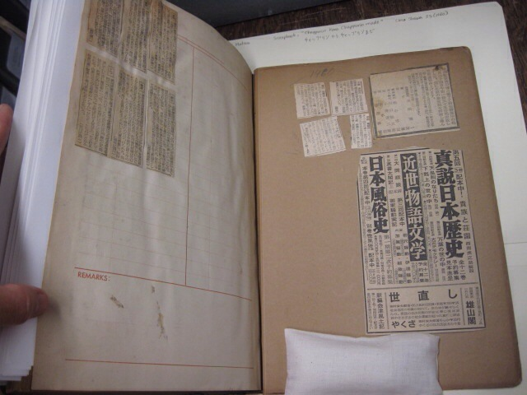
Personal Collections:
Kishi Matsuo/岸松雄 scrapbook, 1960
1 of 29 scrapbooks created by Kishi Matsuo

Slide 16
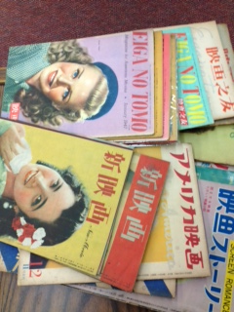
戦後雑誌, GHQ period
戦後雑誌, GHQ period
Postwar magazines（1946～）

Slide 17
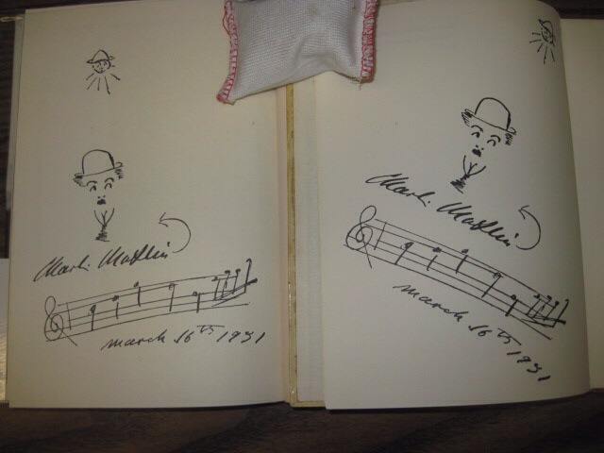
Books autographed by Charlie Chaplin on March 16, 1971

Slide 18
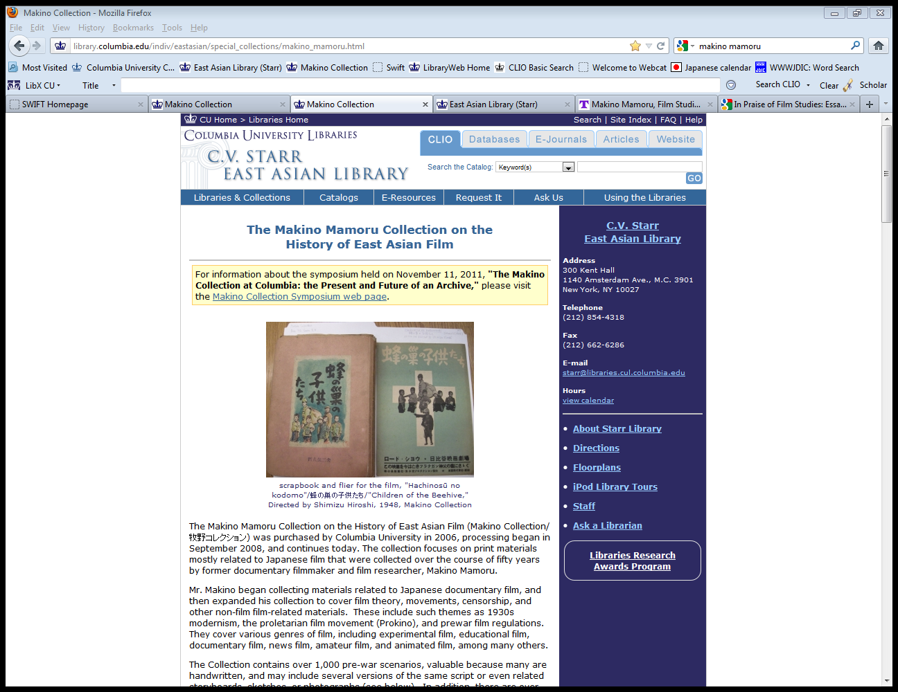
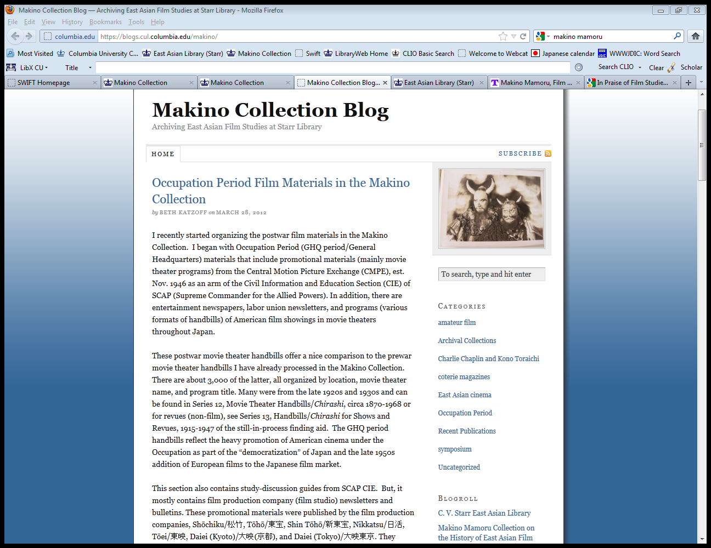
Makino Website and Blog
Website
Blog
http://library.columbia.edu/indiv/eastasian/special_collections/makino_mamoru.html
https://blogs.cul.columbia.edu/makino/

Slide 19
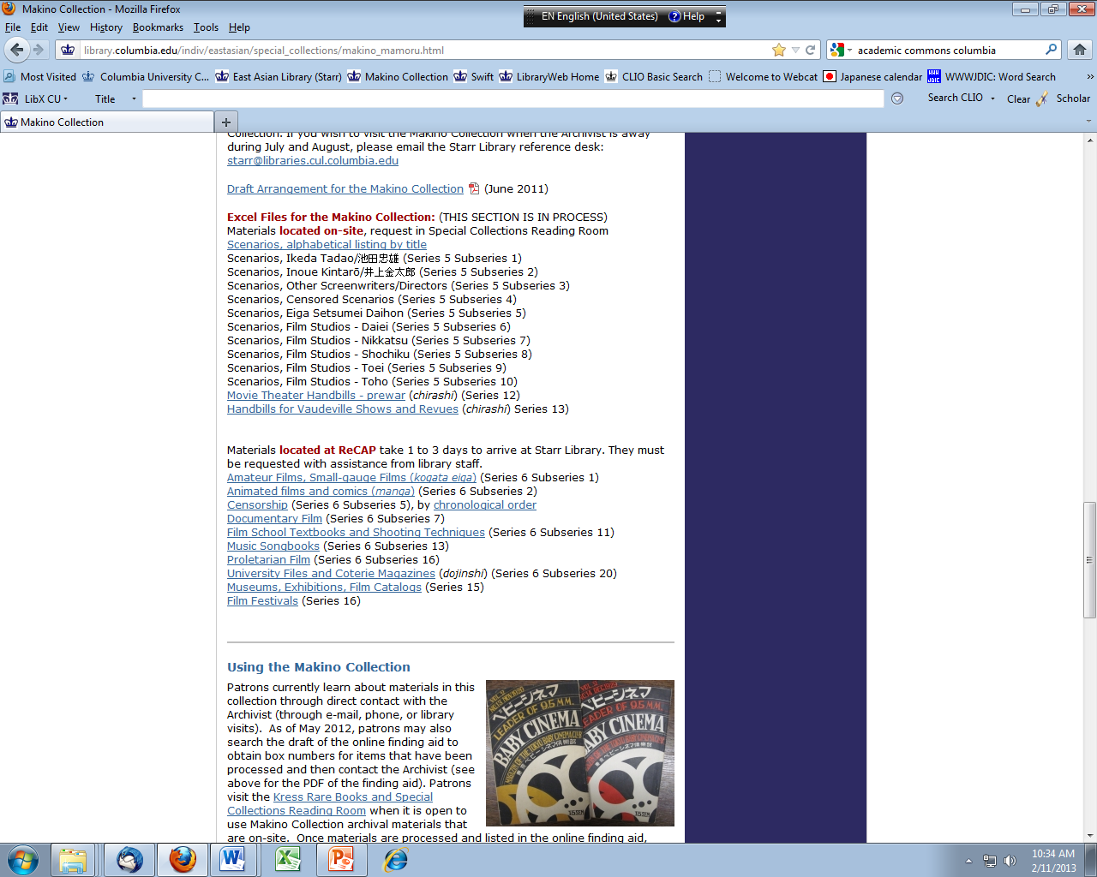

Slide 20
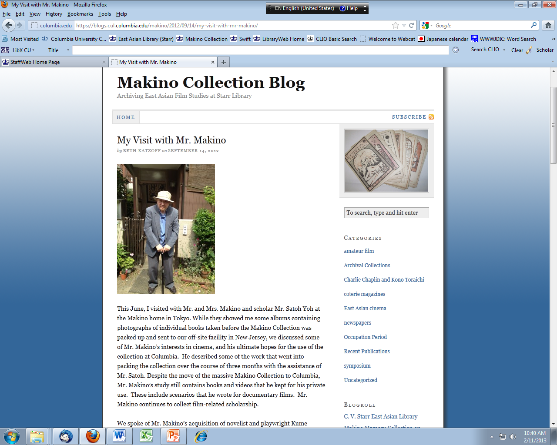

Slide 21
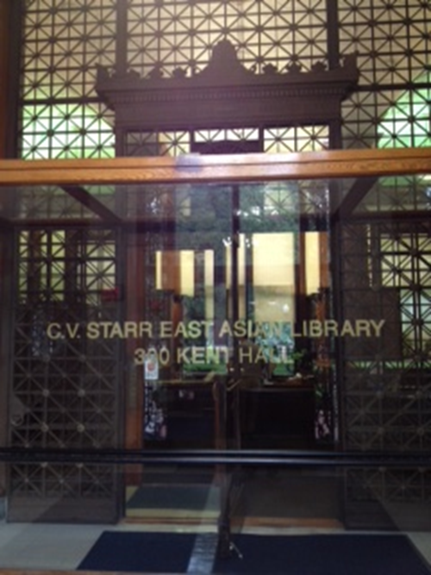
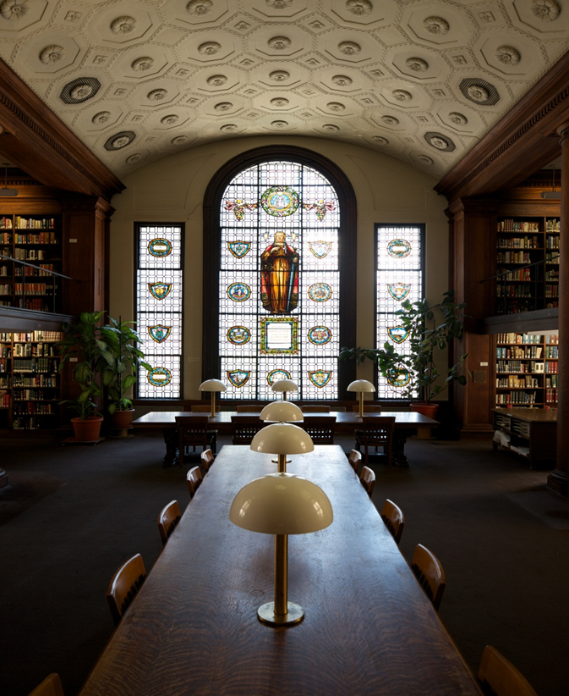
Columbia University
C.V. Starr East Asian Library

